Slide 1
Future of health and care in Sefton
Eleanor Moulton
Integrated Social Care and Health Manager
Sefton Integrated Care Partnership and Sefton Council

Slide 2
Integration
Long term aim for Sefton health and care services
Person focused care and support
Everyone working together
Avoids duplication
Better value for money
Getting it right first time
Notes:
An idea that's been around for a long time, it would make things easier for the person who needs Care and Support, if they only have to tell their story once, it doesn’t matter which door they go through they will get everything they need. It stops things being done twice and costs less money if its done in the simplest and most straightforward way with everyone working together to do the best they can for the person in front of them.

Slide 3
New laws to help integration
Nov 2020 to Feb 2021: NHS England consulted on ideas; Integrating care: Next steps to building strong and effective integrated care systems across England
19 February 2021: White Paper; 'Integration and innovation: working together to improve health and social care for all’ published:
“…this Bill is about backing our health and care system and everyone who works in it. Our proposals build on the NHS’s own in the Long-Term Plan. We’re also outlining steps to support everyone who works to meet people’s health and care needs. Taken together, they will help us build back better after Covid”
July 6: Health and Care Bill laid before parliament.
Notes:
1) It suggested ways everyone who works for a Health or Care Organisation can work together, and it built on what responding to COVID has taught us.

Slide 4
July 2021 – Health and Care Bill
Notes:
Place based partnerships – everyone that works in Sefton for the NHS or Social Care
Integrated Care Board – Will decide on things which stay just in the NHS for Cheshire and Merseyside,
Integrated Care Partnership will organise things and work with the palce based parttnserhisp to try and get the best offer for Sefton as one 9 places in Cheshire and Merseyside
Provider Collaboratives – NHS trusts working together on big footprint around things they do well. Like Specialist Mental Health, this is still not fully decided.

Slide 5
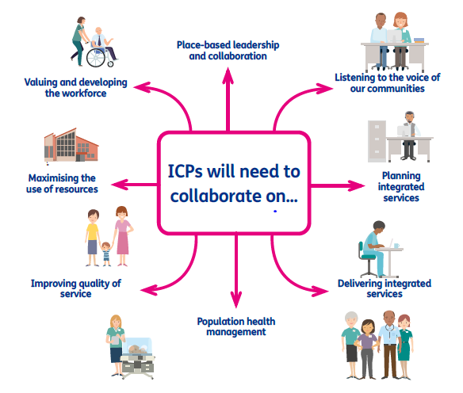
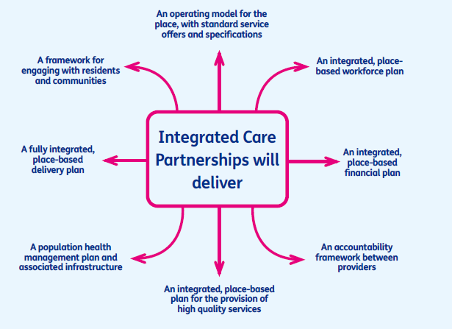
What will we do in Sefton
Place based partnerships
Place based partnerships
Notes:
A Place based partnership of locally you might hear it called the Sefton Integrated Care Partnership (ICP) is a collaboration of planners and providers across health, local authority and the wider community, who take collective responsibility for improving the health and wellbeing of residents within a place, the place of Sefton.

Slide 6
What is being asked of each Place Based Partnership ?
All age service provision at place level, working together to simplify and modernise care and implement service models which deliver improved outcomes
Public health and wider community development
Community-based wellbeing support, including social prescribing activities, VCFSE provision and local access to green spaces, and leisure facilities
GP and wider primary care, delivered through Primary Care Networks
Community mental health care
Urgent & emergency care, including physical & mental health (in part through ‘system’ networks)
Ongoing management of long term conditions, including the use of skills, expertise and resources that have historically been accessed via referral to acute care services
Social care, education, housing, employment and training support
Notes:
What we are being asked to deliver

Slide 7
The Cheshire & Merseyside ICS Core Purposes
Choose alternative slide title headers
Improving
outcomes in population health and health care
Tackling
inequalities in outcomes, experience and access
Enhancing
productivity and value for money
Helping
the NHS support social and economic development
Notes:
What’s driving us?

Slide 8
What will be different?
‘One team’ approach – free from organisational barriers and using our joint resources
Making decisions together and reducing need for separate meetings
Pooled budgets to get the best value for money and make the most of the Sefton £
What people in Sefton need isn’t changing – the way the health and care system meets those needs is changing
Notes:
We are being asked think of ourselves as one team and focus on what people really need and to forget about barriers like different organizations or doing things separately without thinking about things together as part of our jobs and with the public. This will use the best of what we have available to us
Now things might have to go through two or three separate sets of meetings to decide things and get them done in the future there will be one big meeting that everyone makes a decision together
We will put our money together in a pooled budget to help get the most out of it.
This doesn’t change what people in Sefton need, it changes the way Health and Care do something about it.
The next slides explain that we already know what has to be done, through the HWBB Strategy and NHS 5 year Plan, Sefton2gether.

Slide 9
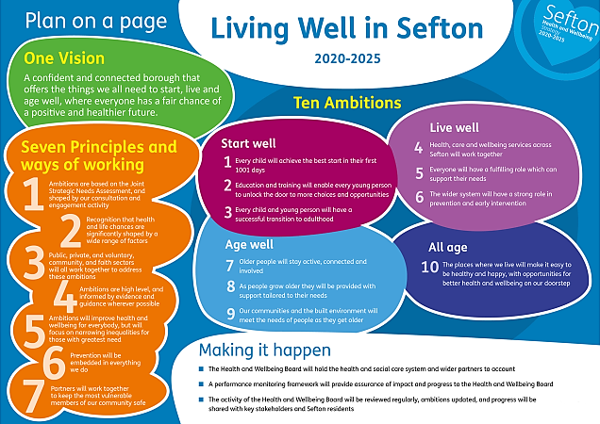
What is an ICP and what does it do?
Notes:
Work underway to deliver a single set of combined HWBS and Sefton2gether priorities, and indicators that will tell us we are making a difference.

Slide 10
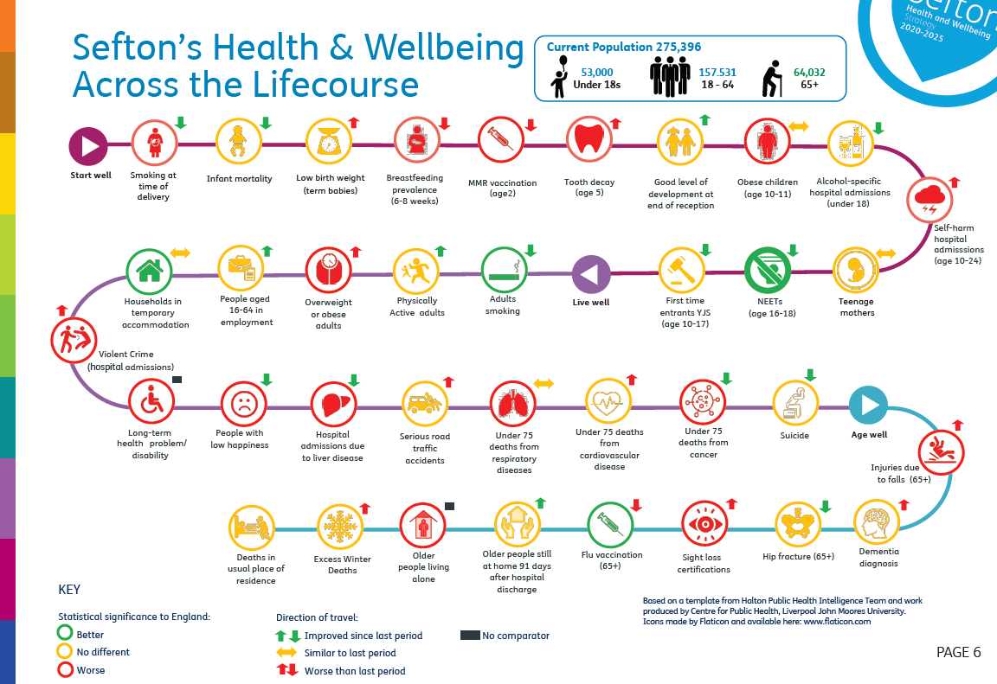
What is an ICP and what does it do?

Slide 11
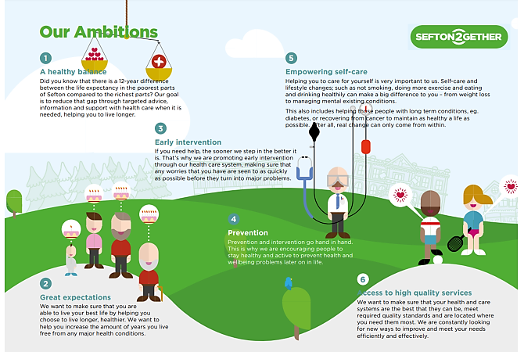
What is an ICP and what does it do?

Slide 12
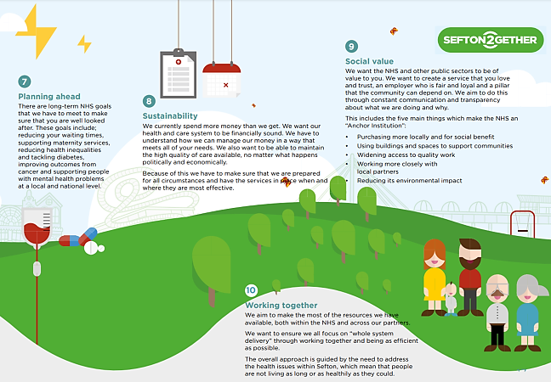
What is an ICP and what does it do?

Slide 13
Money available
Combined spend of CCGs and Sefton Council Adult and Social Care:
£748 million
Notes:
Together the CCGs in Sefton and Adult and Children's Social care spend £748 million pounds, that’s a lot to try and make a big difference with.

Slide 14
Current priorities
Continue rapid development of Sefton Integrated Care Partnership to be ready for April 2022.
Demonstrate our readiness and our plans for Sefton, so that the government feel able to trust us with extra money and responsibility.
Putting together all we know (data and intelligence) to support ‘Population Health Management’
Strengthening community engagement so our work is driven by both hard and soft intelligence
Co-create a good culture and principles of how we work together
Agreeing a single plan for Sefton that delivers on the H&WB Strategy and Sefton2gether
Testing this different way of working
Helping people as early as possible or giving them the tools to help them prevent poor health
Notes:
To keep working on developing a Sefton Integrated Care Partnership quickly so we are ready for when the bill is law in April 2022.
To be able to show that we are ready and we know what we are going to do so that the government feel able to trust us with extra money and responsibility.
Putting together all that we know – data and intelligence to create something called Population Health Management through a Sefton Intelligence Hub
Strengthening our community engagement so our work is driven by both hard & soft intelligence
Work to create a good culture and principles of how we work together
Agreeing a single plan for Sefton that delivers on the H&WB Strategy and Sefton2gether
Start testing out this different way of working
Helping people as early as possible or giving them to tools to help stop them ever needing help rather than waiting for something bad to happen and a lot of care and support be needed.

Slide 15
Example: Mental Health Care
Mental Health Review: A review of adult mental health services led by the CCGs and Sefton Council was approved by the Health & Wellbeing Board in March 2021
Phase one of the review: Focused on data analysis and partnership development and was undertaken between April and July 2021.
A Mental Health Strategic Review Group: Established with wide-ranging membership to produce themes and recommendations for how we design services and deliver them going forward.
Notes:
Mental Health Review - A review of adult mental health services led by the CCGs and Sefton Council was approved by the Health & Wellbeing Board in March 2021
Phase one of the review has focused on data analysis and partnership development and was undertaken between April and July 2021. A Mental Health Strategic Review Group with wide-ranging membership was established to advance the work and met seven times over this period to produce themes and recommendations for how we design services and deliver them going forward.

Slide 16
Example: Care Home Forum
Multi-agency approach to managing COVID-19 for care homes
Looked beyond organisational barriers to focus on what would help the most
Helped roll out vaccinations in care homes quickly
Ensured enough PPE was available
Helped find more staff when required
Helped ensure residents received the right medication
Helped bring back visitors safely
Commitment to continue working together to get the best for people who live in Care Homes
Notes:
The Care Home Forum – During COVID a group of people from hospitals, District Nurses, GPs, all different people from across the council and CCG, met every day and saw what was happening in care homes and thought about who we could help, then whoever was best did the thing that would help the most. We didn’t think about the rules of who has a contract to do it, or whether their boss had asked it was just doing the right thing and we changed loads helping roll out vaccinations really quickly, making sure they all had enough PPE, helping them find more staff, to get the right medication, getting visitors back in safely. This has led to a commitment to keep working together like this to get the best offer for people who live in Care Homes

Slide 17
Example: Sefton Integrated Care Team
Invaluable support for vulnerable during pandemic
Providing assessment, intervention and coordination of care via remote MDT
Shared responsibility, risk management, governance structures, planning and monitoring of individuals’ care
ICT coordinators helped secure COVID-19 tests for social workers to ensure services were maintained
ICT supported Care Home staff, residents and families to minimise distress from impact of the pandemic
Notes:
ICT approach aligned across the Sefton Borough (not just a South Sefton initiative). This means that staff are covering a smaller area of the borough and that all staff are becoming more familiar with the roles and responsibilities of all within each ICT area.
The ICT’s have been invaluable to support the work that has been required to support vulnerable people as a consequence of the COVID-19 pandemic. The ICT Multi-disciplinary Teams have continued to undertake assessment, intervention and coordination of patient/service user care by utilising remote technology to ensure that the most vulnerable people continue to receive an integrated approach to support their needs.
the ICT coordinators have attended Social Work team meetings and have supported social workers with issues such as securing COVID tests to enable services to be put in place for patients/service users in a timely manner.
Stronger links with the care homes across Sefton and care home matrons have been developed, and all care homes are now aligned to ICT sites. this approach has ensured that recent home closures experienced have been fully supported across all partner organisations thus minimising the distress of a home closure for both the resident/their family members and the staff team within the care homes.
Although the COVID-19 pandemic has presented a significant challenge for all system partners, the ICT approach has enabled the minimisation of risk for individuals during the COVID period due to this joined up approach and sharing of responsibility and risk management. There is now an opportunity to build on this approach to continue to deliver improved outcomes for the residents of Sefton.

Slide 18
Your views
Do you think that Sefton organisations working closer together will improve services locally?
Do you feel these proposals align with our local plans (Sefton 2gether / Living Well Sefton)?

